Slide 1

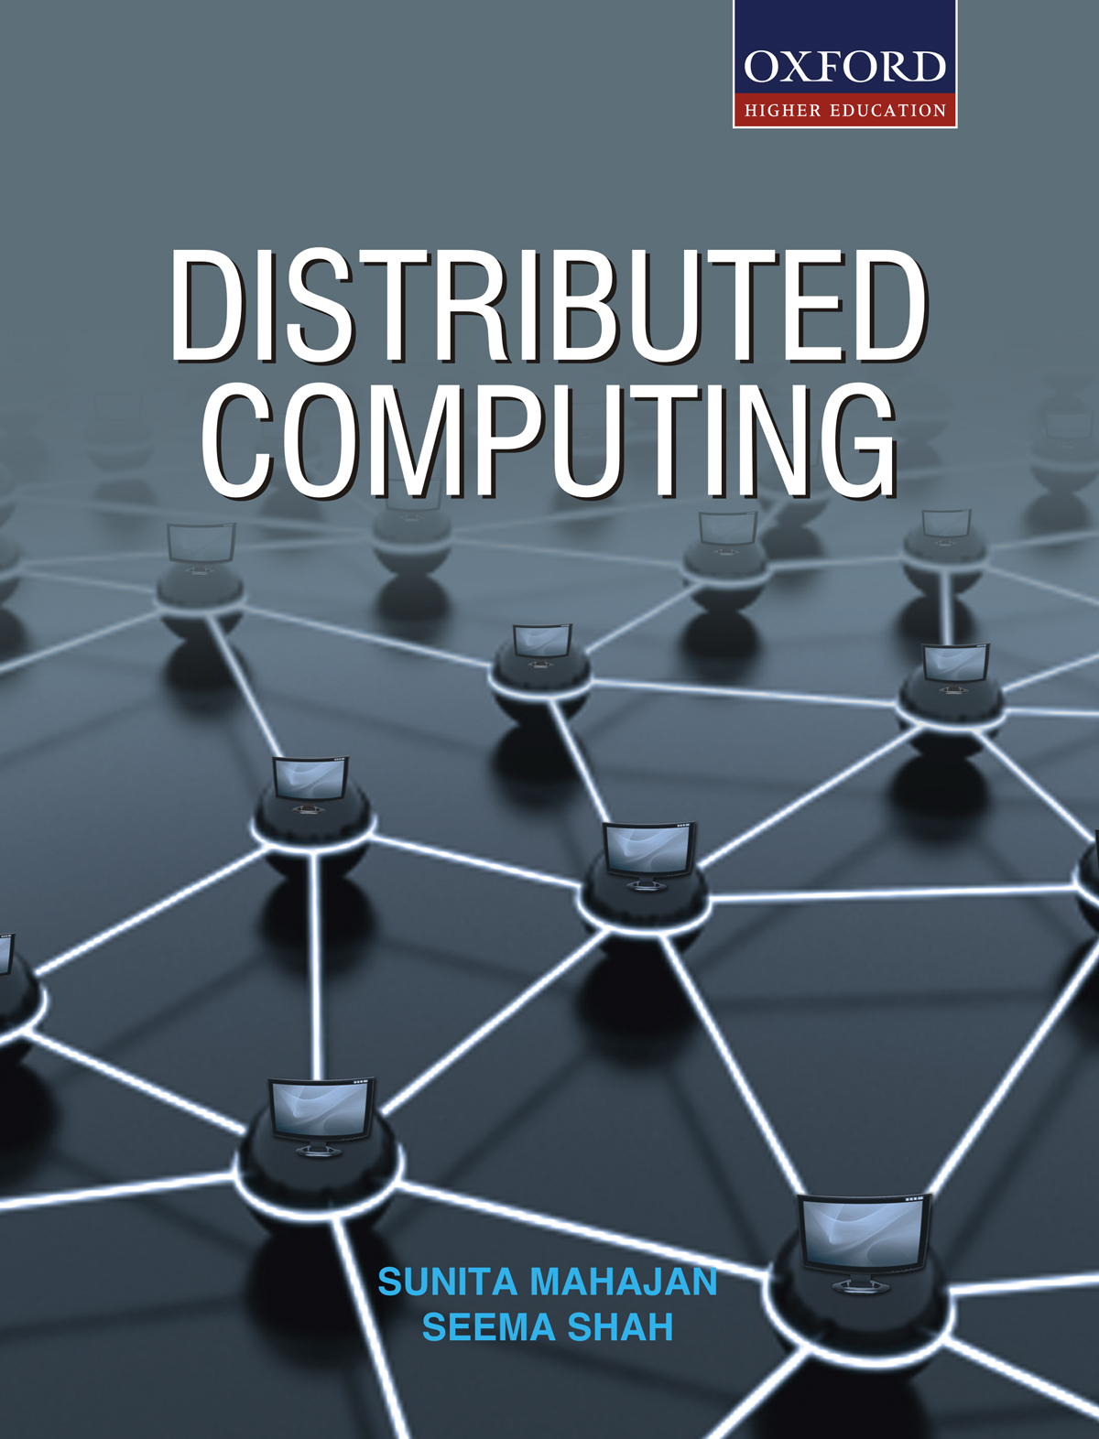
DISTRIBUTED COMPUTING
Sunita Mahajan, Principal, Institute of Computer Science, MET League of Colleges, Mumbai
Seema Shah, Principal, Vidyalankar Institute of Technology, Mumbai University

Slide 2
Chapter - 4
Remote Communication

Slide 3
Topics
Introduction to Remote Communication
Remote Procedural Call Basics
RPC Implementation
RPC Communication
Other RPC Issues
Case Study: Sun RPC
Remote invocation Basics
RMI Implementation

Slide 4
Introduction to Remote Communication

Slide 5
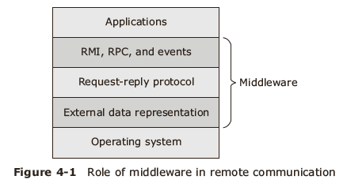
Introduction
Middleware

Slide 6
Remote Procedural Call Basics

Slide 7
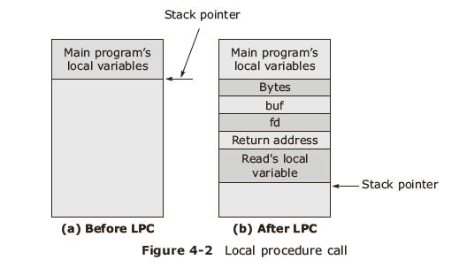
Local Procedure Call

Slide 8
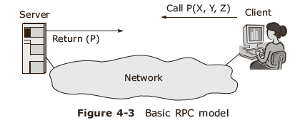
Remote Procedure Call
Basic RPC operation

Slide 9
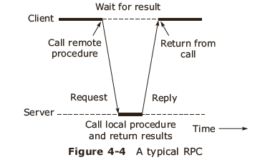
RPC operation

Slide 10
Elements of RPC mechanism implementation
Client
Client stub
RPC Runtime
Server stub
Server

Slide 11
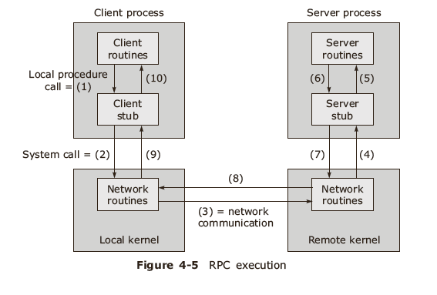
RPC Execution

Slide 12
Stub generation
Manual generation
Auto generation using Interface Definition Language (IDL)

Slide 13
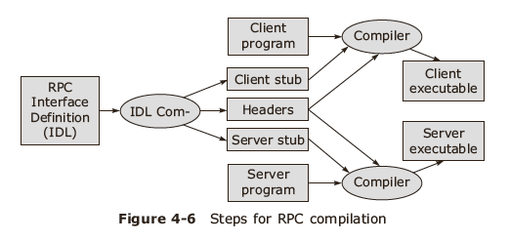
RPC Compilation

Slide 14
RPC Implementation

Slide 15
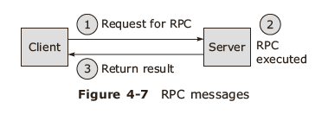
RPC implementation
RPC messages:
  Call / Request
  Reply

Slide 16
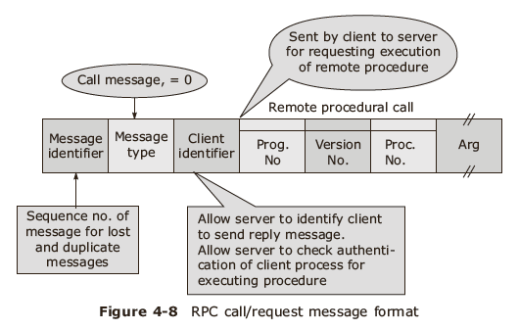
RPC Call/ Request message

Slide 17
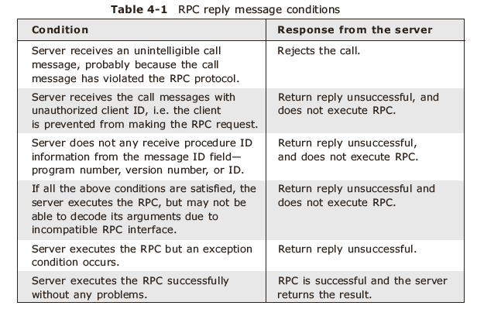
RPC reply conditions

Slide 18
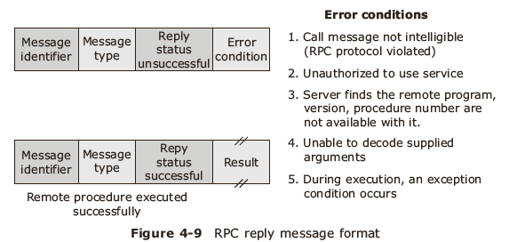
RPC reply message

Slide 19
Parameter Passing Semantics
Call-by-value semantic
  Marshalling
Call-by –reference semantic
Call-by-copy/restore semantic
Call-by-value copies all parameters into a message before transmission . Call-by-reference passes pointers to the parameters that are passed from the client to the server. Call-by-copy/restore uses temporary storage accessible to both programs

Slide 20
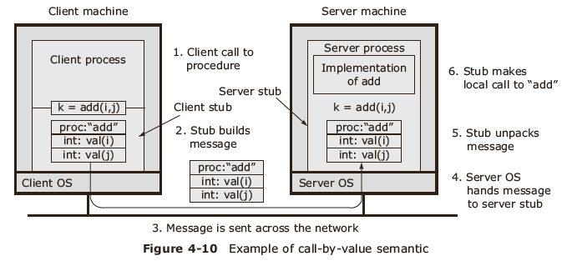
Call-by-value semantic

Slide 21
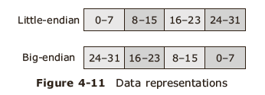
Byte ordering

Slide 22
Server management
Server implementation
  Stateless server
  Stateful server
Server management
  Instance per call
  Instance per session
  Persistent servers

Slide 23
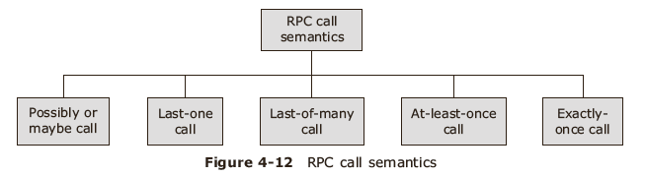
RPC communication
RPC call semantics

Slide 24
Orphan calls
Calls whose caller has expired due to a node crash
Handle orphan calls by using:
  Extermination
  Reincarnation
  Gentle reincarnation
  Expiration

Slide 25
RPC communication protocols
Request protocol
Request/Reply protocol
Request/Reply/ Acknowledge- Reply protocol

Slide 26
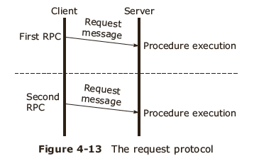
Request protocol

Slide 27
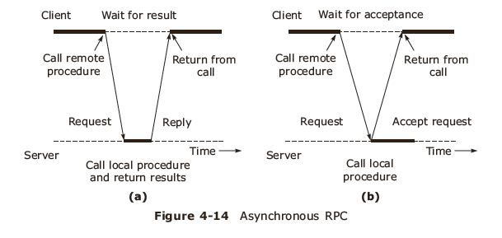
Asynchronous RPC

Slide 28
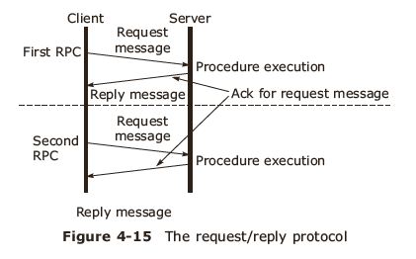
Request/Reply protocol

Slide 29
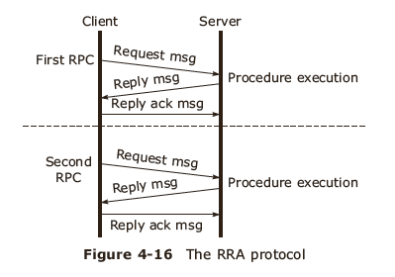
Request/Reply/ Acknowledge- Reply protocol

Slide 30
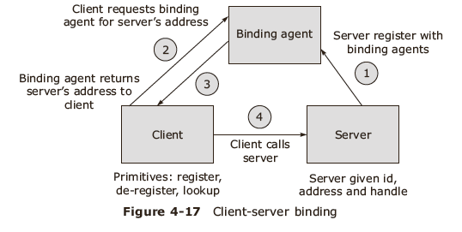
Client server binding process

Slide 31
Client Server binding
Issues
  Server naming
  Server locating
Binding agent primitives
  Register
  Deregister
  Lookup
Types of binding
  Fixed binding
  Dynamic binding
    At compile time
    At link time
    At run time

Slide 32
Other RPC Issues

Slide 33
Other issues in RPC implementation
Exception handing and security
Failure handling
Optimizing RPC execution
Various types of complicated RPCs

Slide 34
RPC in heterogeneous environment
Data presentation
Transport protocol
Control protocol

Slide 35
Failure handling mechanism in RPC
Client cannot find the server
Request from client to the server is lost
Reply from server to the client is lost
Server crashes after getting the request
Client crashes after sending the request

Slide 36
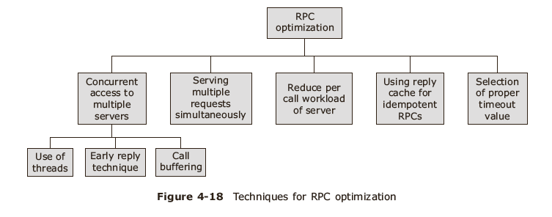
RPC Optimization

Slide 37
Concurrent access to multiple servers
Use of threads
Early reply technique
Call buffering approach
Serving multiple requests simultaneously
Reducing call workload of server
Using reply cache for idempotent RPC

Slide 38
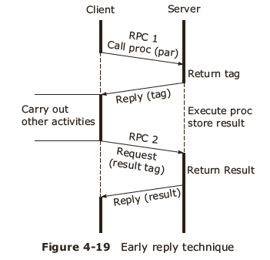
Early Reply technique

Slide 39
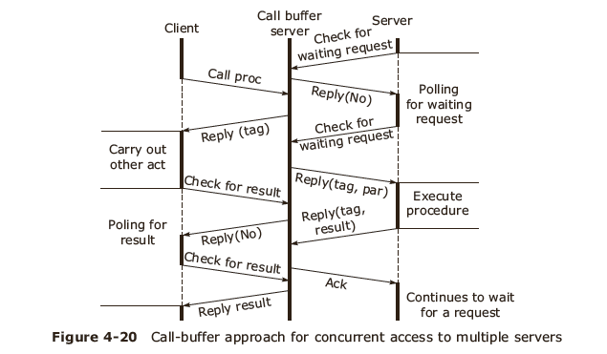
Call buffer approach

Slide 40
Complicated and special RPCs
Complicated RPCs
  RPCs with long duration calls or with gaps between calls
  RPCs with long messages
Special RPCs:
  Call back RPC
  Broadcast RPC
  Batch mode RPC

Slide 41
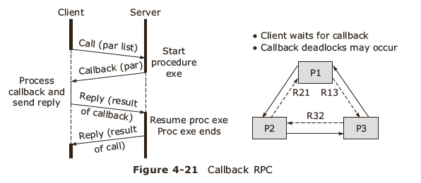
Call back RPC
Client handle is provided to the server
Client process should wait for callback RPC
Handle callback deadlocks

Slide 42
Case Study: Sun RPC

Slide 43
Case Study- Sun RPC
Uses rpcgen compiler which generates
  Header file
  XDR filter file
  Client stub file
  Server stub file

Slide 44
Remote invocation Basics

Slide 45
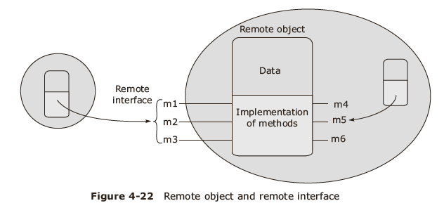
Remote Object Invocation
Distributed object concept
  Remote objects reference
  Remote interface

Slide 46
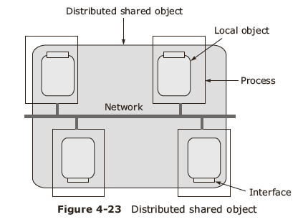
RMI

Slide 47
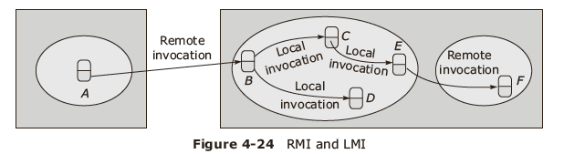
RMI vs LMI

Slide 48
RMI Implementation

Slide 49
RMI implementation
Design issues in RMI
    RMI invocation semantics
    Level of transparency
  Marshalling
  Message passing
  Task of locating and contacting the remote object for the client
      RMI invocation semantics
  Maybe semantics
  At-least-once semantics
  At-most-once semantics

Slide 50
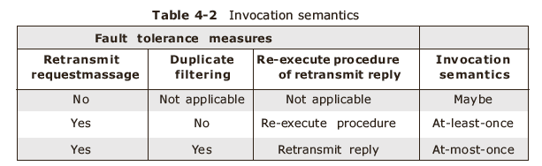
Invocation semantics

Slide 51
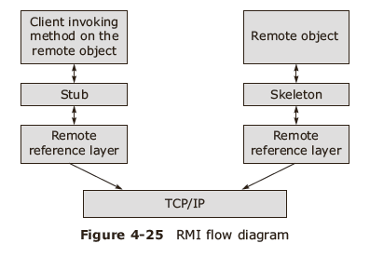
Level of Transparency

Slide 52
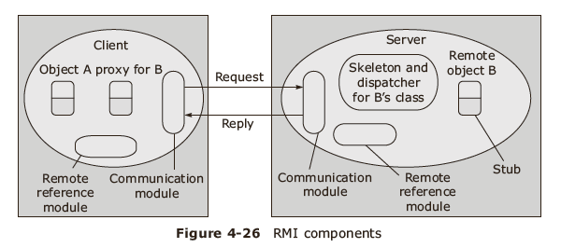
Components of RMI

Slide 53
RMI execution components
Communication module
Remote reference module
RMI software
Server program
Client program
Binder

Slide 54
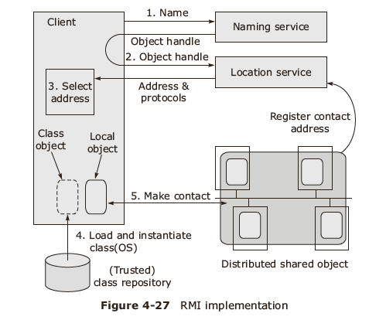
RMI execution

Slide 55
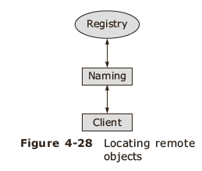
RMI software
Proxy
Dispatcher
Skeleton

Slide 56
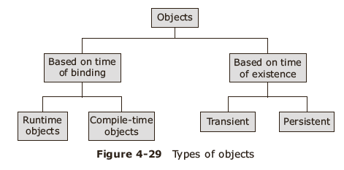
Types of objects

Slide 57
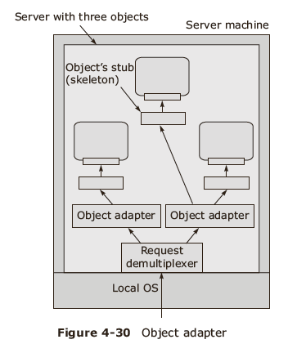
Remote invocation readiness

Slide 58
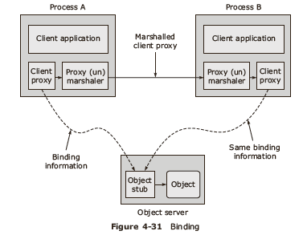
RMI binding
Implicit binding
Explicit binding

Slide 59
Parameter passing in RMI
Pass by value
Pass by reference

Slide 60
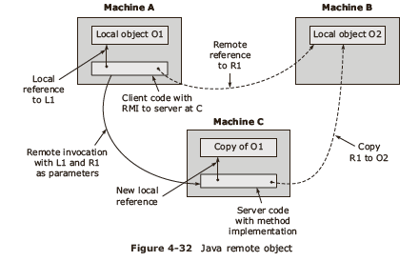
Case study: Java RMI

Slide 61
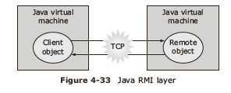
Java RMI layer

Slide 62
Summary
Introduction to Remote Communication
Remote Procedural Call Basics
RPC Implementation
RPC Communication
Other RPC Issues
Case Study: Sun RPC
Remote invocation Basics
RMI Implementation

